Slide 1
Zener diode as voltage regulator
By: nagy richárd, mechatronics, 25223020

Slide 2
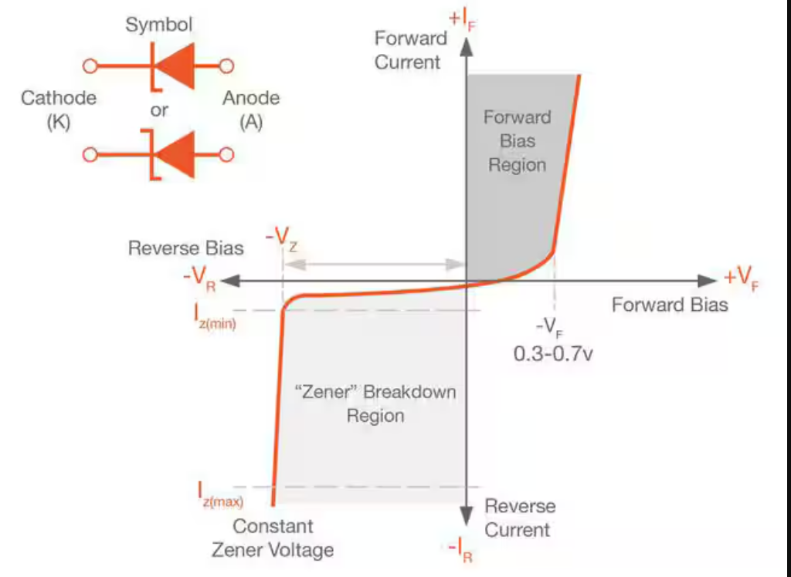
Zener diode characteristic and operation

Slide 3
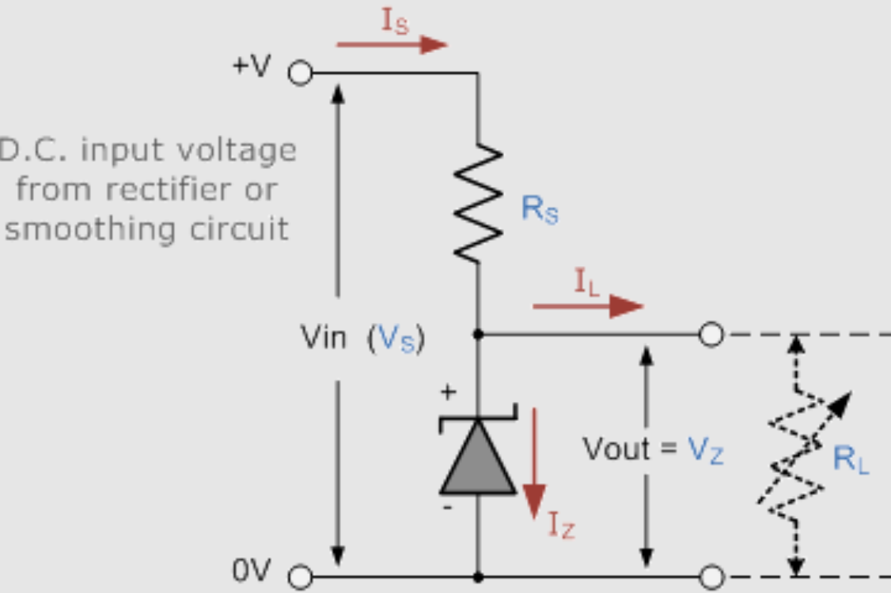
Zenner diode and resistor as a voltage regulator – example ciruit

Slide 4

Zenner diode and resistor as a voltage regulator

Slide 5
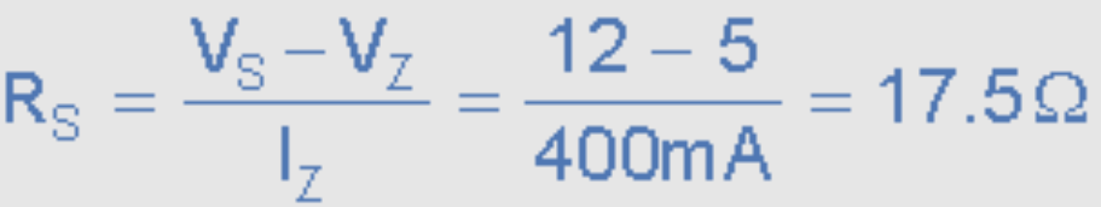
Zenner diode and resistor as a voltage regulator

Slide 6
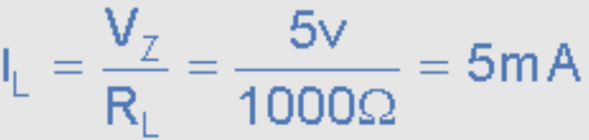
Zenner diode and resistor as a voltage regulator

Slide 7
Zenner diode and resistor as a voltage regulator

Slide 8
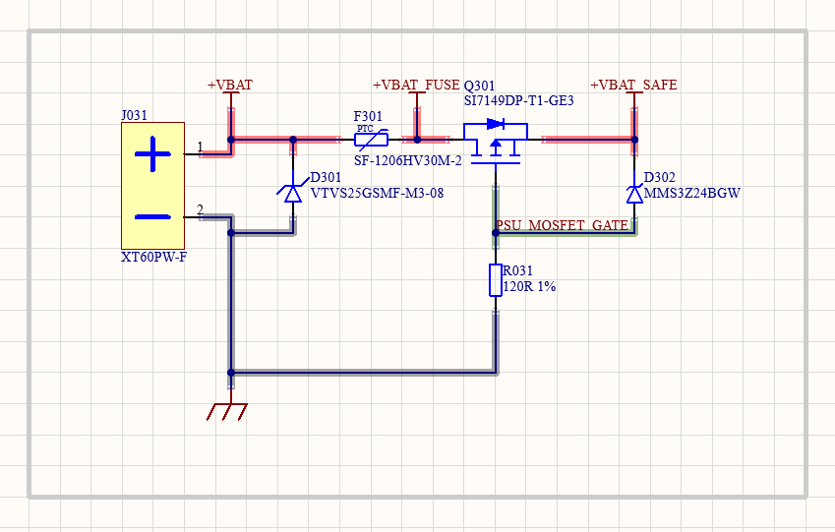
Zenner diode and resistor as a voltage regulator – example

Slide 9


